Slide 1
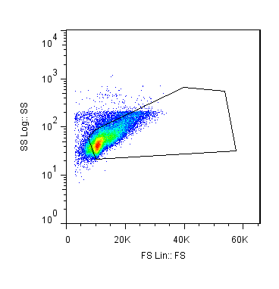
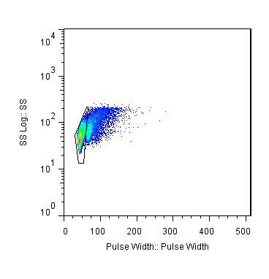
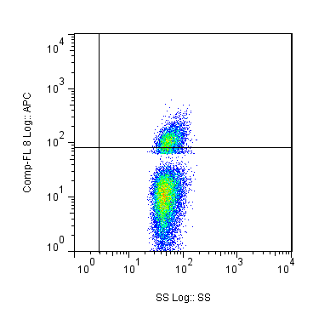
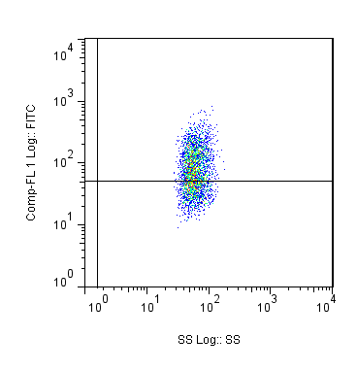
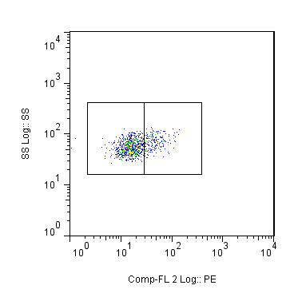
Pre B
Pro B
Lymphocytes
CD19+
Single Cells
Side Scatter
Side Scatter
CD19
IgM
Side Scatter
IgM-
Forward Scatter
Pulse Width
Side Scatter
Side Scatter
CD43

